Slide 1
Riordan Security Planning
Team C CMGT 430: Enterprise Security University of Phoenix August 8th, 2014

Slide 2
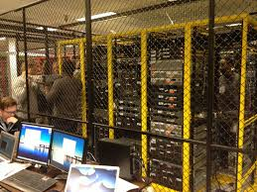
Physical Vulnerabilities
Common Threats
Why be Concerned
How to React
Notes:
Physical Vulnerabilities
Common Threats
A good approach to dealing with access to company data floors is to start from the street and work your way into the actual computer room. To fully protect the Riordan data, cameras should be present on the outside of the facility to oversee all entry points and exit points. Once inside the building, all employees should be mandated to wear a security badge that gives them clearance to whatever rooms or floors they need to be on.
Why be Concerned
Riordan Manufacturing needs to be concerned with physical vulnerabilities because this is where people can get access to your physical infrastructure. Making sure the areas are locked down and secure will allow Riordan to have complete control over their environments.
How to React
Reacting in a proactive manner will allow Riordan to be prepared for any physical threat it may encounter. Having security cameras in outside parking structures is one way to start dealing with physical threats. Computer room floors need to be secure with key access only that does not allow piggy backing onto the floor. Security guards and metal detectors will allow Riordan to have a safer environment for their employees.

Slide 3

Logical Vulnerabilities
Current employees leaking information
Ex employees
Still have access to network
Stolen equipment
Internal threats
Notes:
Logical Vulnerabilities
Not everything is saved to the server in a company, so when an employee is able to obtain company equipment with valuable information, they put the state of the company in jeopardy. Depending on the information on the device, it could expose the company as a whole.
Today, with remote access to job sites, an employee does not have to be in the building to access the network. Not deactivating an ex-employee account gives them the right to have the ability to gain access to sensitive information within the organization.

Slide 4


Prevent Internal Threats
Install employee termination policy
Workshop for upper management
Incorporate simulation of process
Notes:
Prevent Internal Threats
Write out a step by step process when terminating someone to assure they have no access to the company and they do not leave with any confidential information about the company.
Teaching upper management this new police through workshop and simulation will assure that they are able to properly terminate an employee and limit the chances that an employee leaves the organization still having access to the company.

Slide 5

External Threats
Trojan Horse
Denial Of Service
Zombie attack
Notes:
External Threats
They are a couple types of external attacks that can affect a company but most of them enter the network with the accidental assistance of internal sources.
1)Trojan Horses are hard to detect because they hide within the system and start affecting the network.
2)Denial of Service involves the company losing access or their bandwidth being overloaded by an outside source
3)The zombie attacker is able to set up his or her own motives within the system, this leaves the system vulnerable and clients that trust abandon
The fact the company has clients information within their system and clients are at times placing orders, it places not only the company in a vulnerable predicament, but also their clients as well. First step is building that stable security policy for access the network

Slide 6

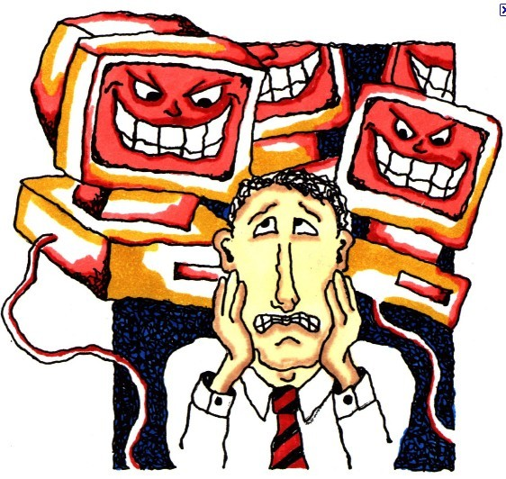
Prevent External Threats
Notes:
Prevent External Threats
To prevent external viruses the company most install a policy as well as incorporate software to add onto the security of the network.
The IT team will oversee the current state of the security policy to evaluate what part of the policy is effective and what can be done to improve the policy.
They will layer the vulnerable area of the network and conduct workshops for new employees on how to proceed with their day-to-day task to assure that they are complying with the policy.

Slide 7
Other Vulnerabilities/Threats
Unpatched Systems
Implementation Flaws
Insecure deployments
Malware infected devices
Shared Context
Notes:
There are many additional vulnerabilities that need to be protected in a large scale enterprise solution.
For instance isolation of all roles, groups, users, and artifacts is important. If proper isolation is not leveraged then security boundaries will not exist.
This introduces many threats against the organization.
Another area of where risk can be introduced is with incorrect deployments and configurations. An example might include using weak encryption, or not enabling an OS level protection.
Vulnerabilities can also appear in unexpected implementation flaws. An example might be a buffer overflow in a native component. These can be very difficult to find and remove.
To help mitigate these risks OS level protections can be leveraged as well as low level system hooking, such as the case with EMET.

Slide 8
Critical vulnerabilities and recommended mitigation techniques
Vulnerability
No printer threshold
Web server bugs
Web server traffic limits
Risk
Delayed productivity
Website repairs/reputation risk
Website repairs/reputational risk
Mitigation Technique
Authentication method including username/password
Validation and latest software version
QoS traffic/packet shapers
Weak database security
Unauthorized access to database
Proper SoA architecture
Network congestions
Communication degradations
Upgrade router configuration
Notes:
No printer threshold:
Causes overload to printer memory
Caused by too many print jobs being executed simultaneously
Creates a DoS attack
Delays productivity
Fix: Use authentication method by associating each print job with a username/password and store in company database
Web Server bugs:
- Bugs allow for cross-site request forgery (CSRF) or cross-site scripting (XSS) exploits
- Tricks system to think command source is trusted
- Causes website to need repairs
- Unstable website affects company’s reputation
- Fix: Perform validation techniques
- Fix: Most current software versions
Web server traffic limits:
- Adversely affected website functionality
- Unstable website affects company’s reputation/sales
- Fix: Use of QoS traffic/packet shapers
Weak database security:
- SQL injection attack
- Caused by inadequate/improper security measures being taken
- Unauthorized access to sensitive data
- Can cause large financial complications
- Potential client loss
- Fix: Use proper SoA architecture to ensure proper database security
Network congestion:
- Too many users communicating through the same router
- VoIP services adversely affected
- Router could have infinite buffers and no retransmission of lost packets
- Fix: Upgrade router configuration to allow for multiple users

Slide 9
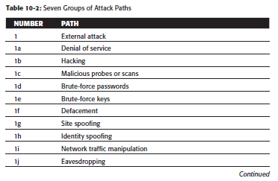
Virtualization Compliance
Section 1 of attack paths for any organization
Attack path analysis
Compliance requirements check list
Can custom-fit any organization
Notes:
- Mitigation can be accomplished for all vulnerabilities with a security method known as virtualization compliance
Can be a list of known attacks and vulnerabilities and mitigation techniques.
This list can be tailored to fit any organization

Slide 10
Conclusions
Why have a Security Plan
What a Good Plan Entails
Growing Document
Notes:
Conclusion:
Why have a Security Plan
Having a good security plan provides company with a backbone in the case of an emergency. This plan lays out what the security goals for a company are and how to follow them to best protect the assets of the company. These standards are created to protect the resources and assets Riordan Manufacturing provide to its customers. Without a security plan in place, companies leave themselves open for attacks on their physical infrastructure as well as their IT network.
What a Good Plan Entails
Identifying the risks that Riordan will face gives the company a real look at the potential threats it may face. Making sure they know the importance of those risks and how they rank amongst the others provides the company with a good insight as to the severity of the risks provided. Knowing the fix techniques that will mitigate these risks to the best of the companies’ ability gives the Riordan the shell of their security plan and how to address the risks.
Growing Document
This plan for Riordan will need to be a working document that grows with the company. As new risks become apparent, new techniques and identification processes will be added and delivered within this security plan. As the assets change for Riordan Manufacturing, the need for the security plan to work and grow with the company will become very important.

Slide 11
References
Anley, C; Felix, J; Richarte, L. (2007). The Shellcoder's Handbook.
Boneh, D. (2013). Cryptography. Stanford Publishing.
Clarke, M. W. (n.d.). Today's Employee, Tomorrow's Defendant? Retrieved from Smith, Gambrell, & Russell LLC: http://www.sgrlaw.com/resources/trust_the_leaders/leaders_issues/ttl17/827/
Conklin, W., White, G., Williams, D., Davis, R., & Cothren, C. (2012). Principles of Computer Security: CompTIA Security+™ and Beyond (Exam SY0-301), Third Edition. McGraw-Hill Company.
Cooper, D., & al., e. (2005). Project Risk Management Guidelines: Managing Risk in Large Projects and Complex Procurements. John Wiley & Sons, Ltd.
Erl, T., Carlyle, B., & al., e. (2014). SOA with REST: Prinicpals, Patterns, & Constraints for Building Enterprise Solutions with REST. Peason Education.
Goleniewski, L., & Jarrett, K. (2007). Telecommunications Essentials. The Complete Global Source, Second Edition. Pearson Education.
Hernandez, S. (2012). Official Guide to the CISSP CBK, Third Edition.
Kreb On Security. (2013, June). Windows Security 101 EMET 4.0. Retrieved from Kreb On Security: http://krebsonsecurity.com/2013/06/windows-security-101-emet-4-0/
Marchewka, J. (2012). Information Technology Project Management. Providing Measurable Organizational Value, Fourth Edition. John Wiley & Sons Inc.
Morimoto, R. (2010). Windows Server 2008 R2 Unleased, 1st Edition. Pearson Education, Inc.
Silberschatz, A., Galvin, P., & Gagne, G. (2012). Operating System Concepts, Eighth Edition. John Wiley & Sons.

